Slide 1


DEPARTMENT OF CSE (ARTIFICIAL INTELLIGENCE AND MACHINE LEARNING)
AN APPLICATION-BASED ASSESSMENT AND ANALYTICS PLATFORM
A. MOHIT VENKAT SAI - 217R1A66D0 A. ARUN KUMAR - 217R1A66D2 R.VEDHAVYAS - 217R1A66H7
Under the guidance of
KORIPALLI NAGAMANI
ASSISTANT PROFESSOR

Slide 2
1
TABLE OF CONTENTS
Abstract
Introduction
Existing System
Disadvantages
Proposed System
Advantages
Hardware Requirements
Software Requirements
System Architecture
Use case Diagram
Sequence Diagram
Class Diagram
Algorithms
Screenshot
Result Analysis
Conclusion
Any Queries

Slide 3
2
ABSTRACT
This project presents a web application that leverages the LLM’s API’s to facilitate automated document analysis, question generation, and answer evaluation. The application allows users to upload documents, from which key topics are extracted using natural language processing techniques.
Users can upload documents in various formats (e.g., PDF, DOCX). The platform automatically processes and analyzes the content to extract key topics using NLP techniques..
Generates diverse question types, including multiple-choice, short answer, and descriptive questions, tailored to the document’s content.
It leverages different Large Language Models (LLMs), such as GPT, Claude, and LLaMA, to generate relevant and contextually accurate questions based on the extracted topics.
This hybrid approach combines the strengths of large language models with proven algorithms to create a robust educational tool for automated assessment.
The application is designed to assist both students and educators by streamlining the evaluation process and providing personalized insights based on document content.

Slide 4
3
EXISTING SYSTEM
In the field of automated document analysis, question generation, and answer evaluation, there are several existing tools and platforms that partially or fully address the tasks you aim to achieve. However, these systems typically focus on specific aspects such as question generation, assessment, or content summarization, rather than integrating all these features into a single solution
Which Includes:
Manual Process
Question Generation Systems
Quiz Generation Systems
Lacking the capability to provide Enhanced evaluations

Slide 5
4
DISADVANTAGES
Fragmented Tools: Existing systems often use separate tools for document analysis, question generation, and answer evaluation, leading to inefficiencies and integration issues.
Manual Processes: Many tools require manual input for question creation and evaluation, making them less efficient and scalable.
Contextual Understanding: AI models in existing systems might struggle with understanding the full context of complex documents, leading to less relevant questions.
Lack of Personalization: Existing systems may not provide personalized feedback or adapt to the user’s knowledge level, reducing the effectiveness of the evaluation.

Slide 6
5
PROPOSED SYSTEM
It is an advanced web-based platform designed to streamline the process of document-based assessments for engineering students. The system leverages the several LLM’s API to generate questions based on document content and evaluates student responses with detailed analytics.
METHODOLOGIES
Document Upload and Processing
Document Analysis and Question Generation
User-friendly design and Personalization
Proper Analysis
AI-Powered Scoring

Slide 7
ADVANTAGES
6
The proposed system automates question generation, answer evaluation, and performance analysis, greatly reducing the manual effort required by educators and increasing the Student growth
Integrated Solution: Combines document processing, question generation, and answer evaluation into a unified platform.
AI-Driven Insights: Leverages advanced AI models for accurate question generation and detailed answer evaluation.
Scalable and Flexible: Designed to handle large volumes of data and user interactions, with flexible customization options.
Enhanced User Experience: Provides an intuitive interface and personalized feedback to improve student learning outcomes.
Comprehensive Analytics: Offers detailed performance analytics and trend analysis to support educators and students

Slide 8
SOFTWARE REQUIREMENTS
Operating system : Windows
Coding language : PYTHON,
Front-End : HTML,CSS, JavaScript,TypeScript,Vite
Back-End : React.js, Node js
API’s : OpenAI API, Gemini API and Huggingface transformers
7

Slide 9
HARDWARE REQUIREMENTS
Processor : Ryzen 5
Ram : 8GB(Min)
Hard Disk : 50GB
Key Board : STARNARD WIDOWS KEY BOARD
Mouse :THREE BUTTON MOUSE
Monitor :SVGA,HDMI
8

Slide 10
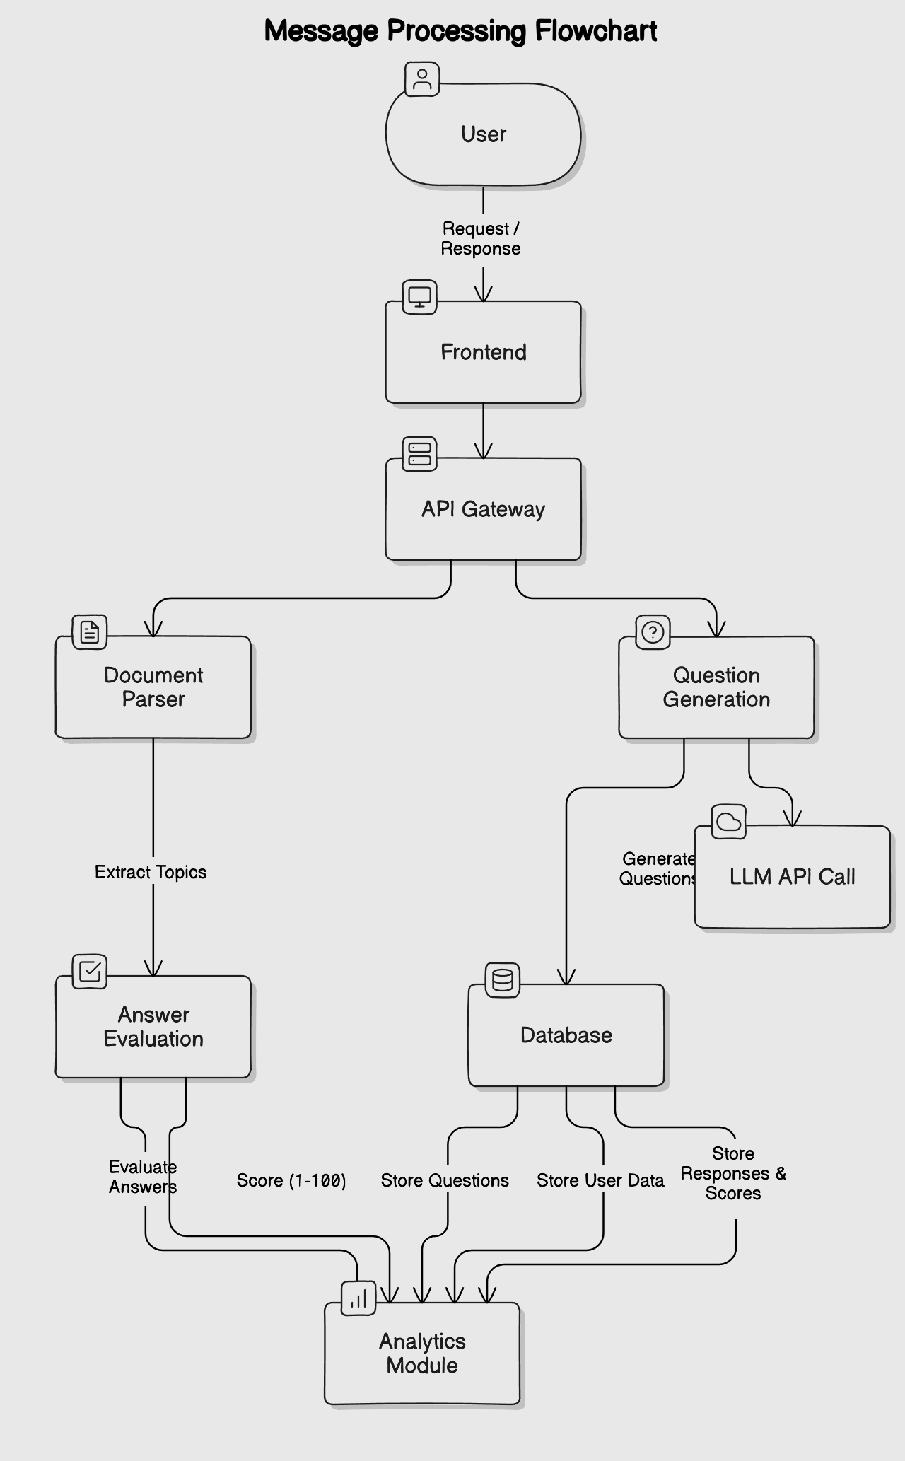
SYSTEM ARCHITECTURE
9

Slide 11
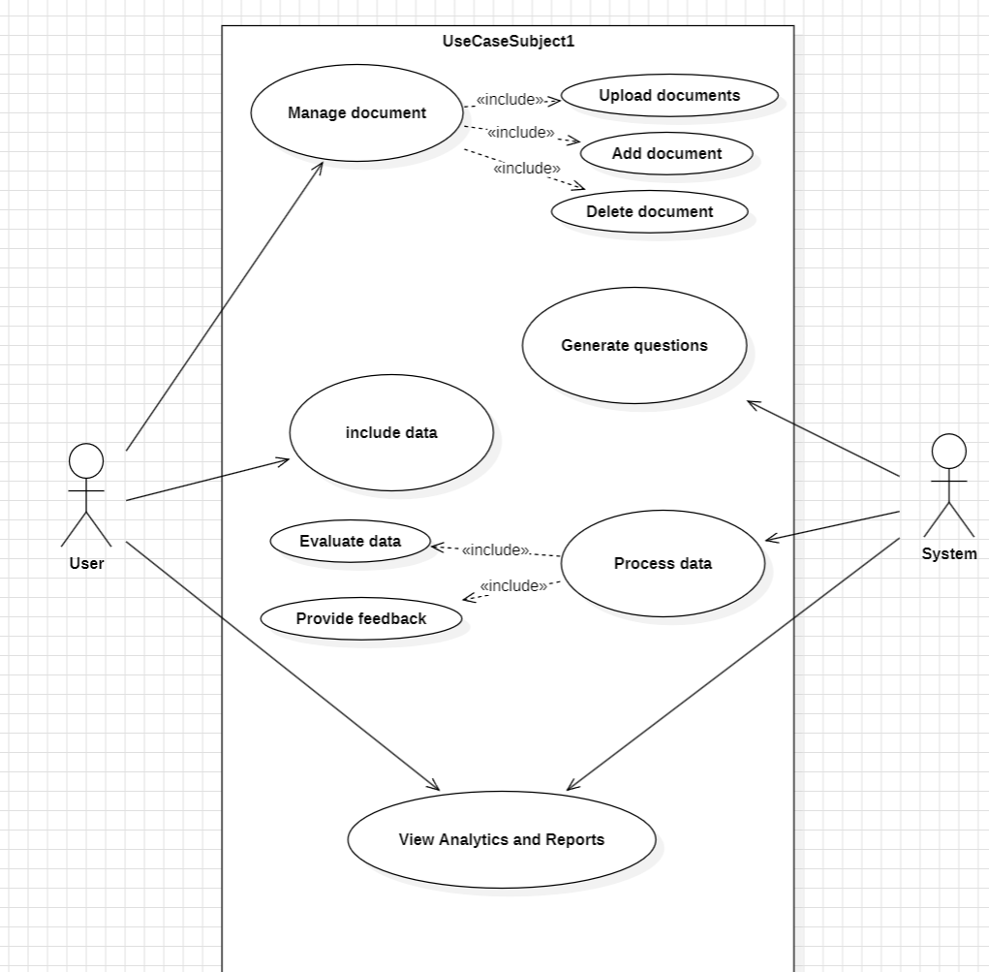
USECASE DIAGRAM
10

Slide 12
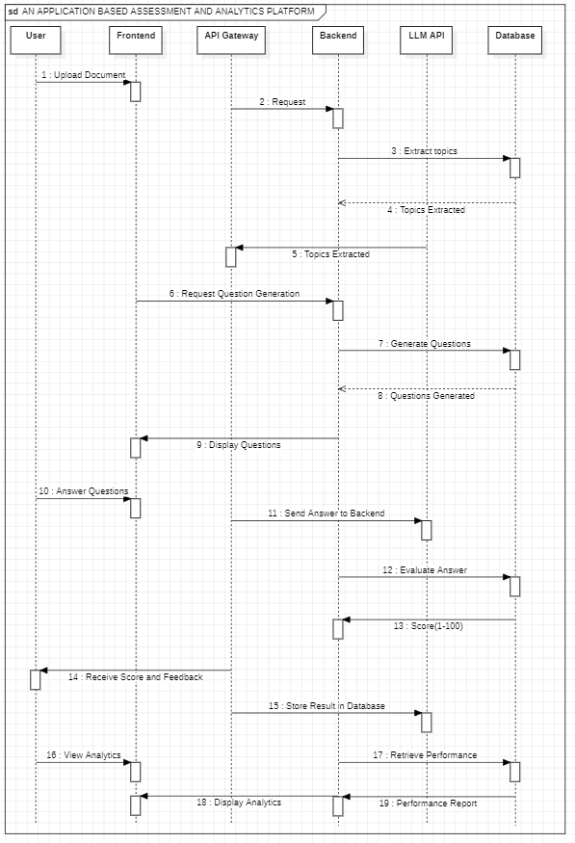
SEQUENCE DIAGRAM
11

Slide 13
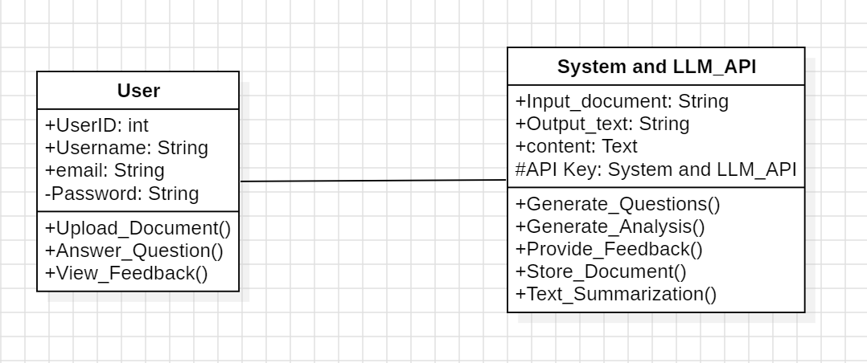
CLASS DIAGRAM
12

Slide 14
13
ALGORITHMS
Large Language Models (LLMs) operate by utilizing a combination of multiple interdependent algorithms and techniques, rather than relying on any single, unique algorithm. These models integrate foundational concepts such as tokenization, attention mechanisms, and embedding methods, alongside advanced optimization and inference strategies. This holistic approach allows them to process, analyze, and generate human-like text efficiently. By blending these diverse algorithms, LLMs achieve their versatility and performance across various tasks, without any single algorithm being exclusively pivotal.

Slide 15
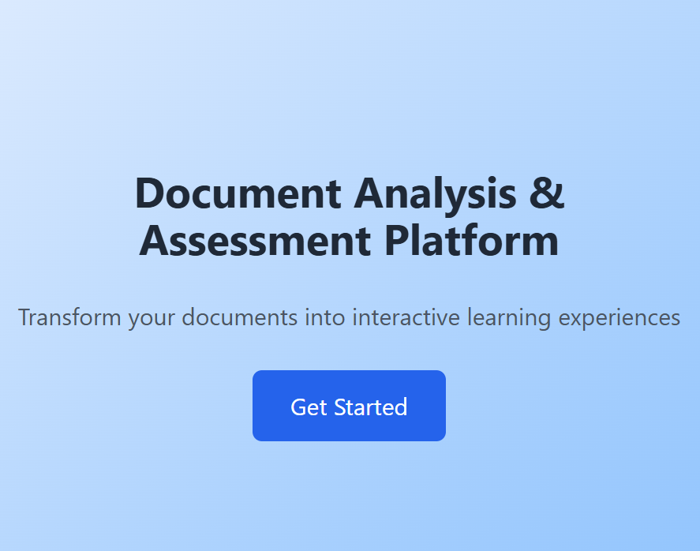
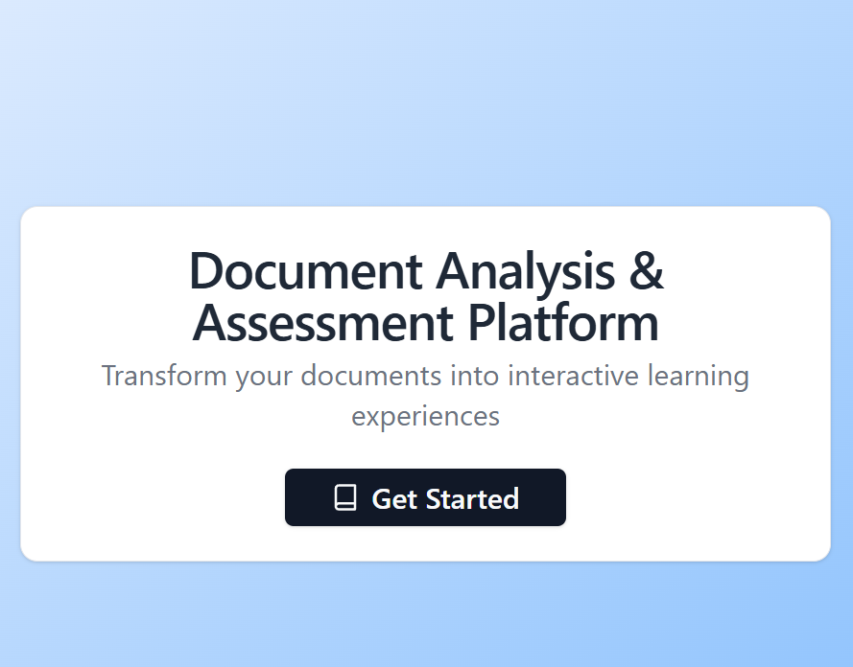
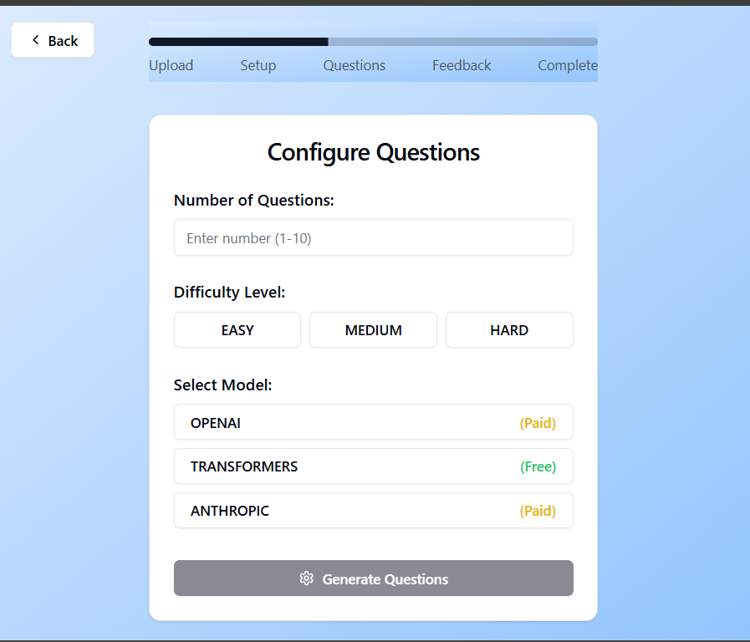
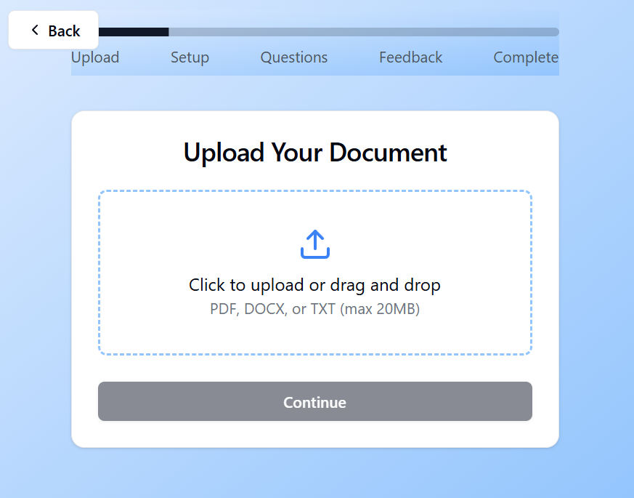
SCREENSHOTS
14

Slide 16
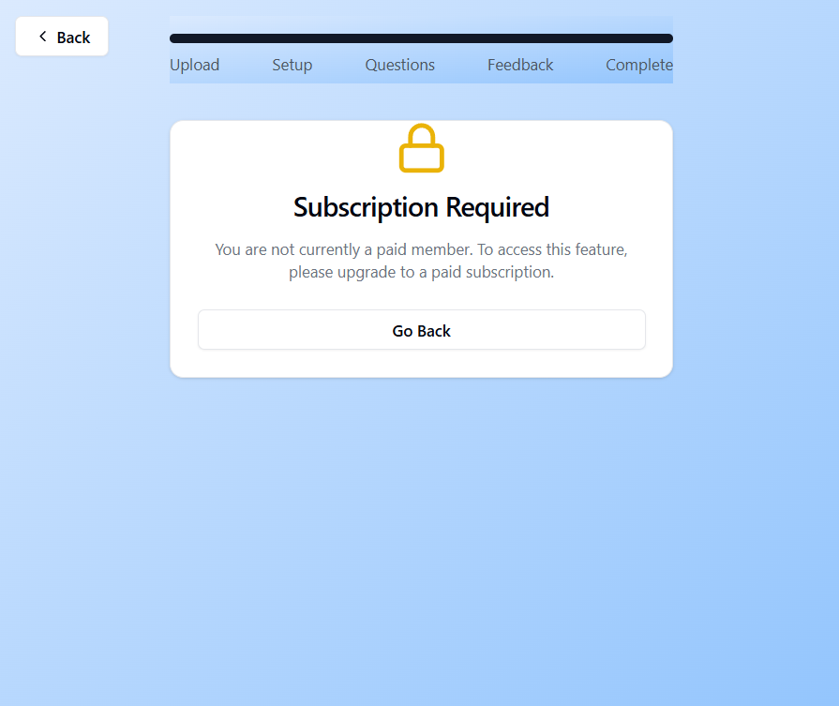
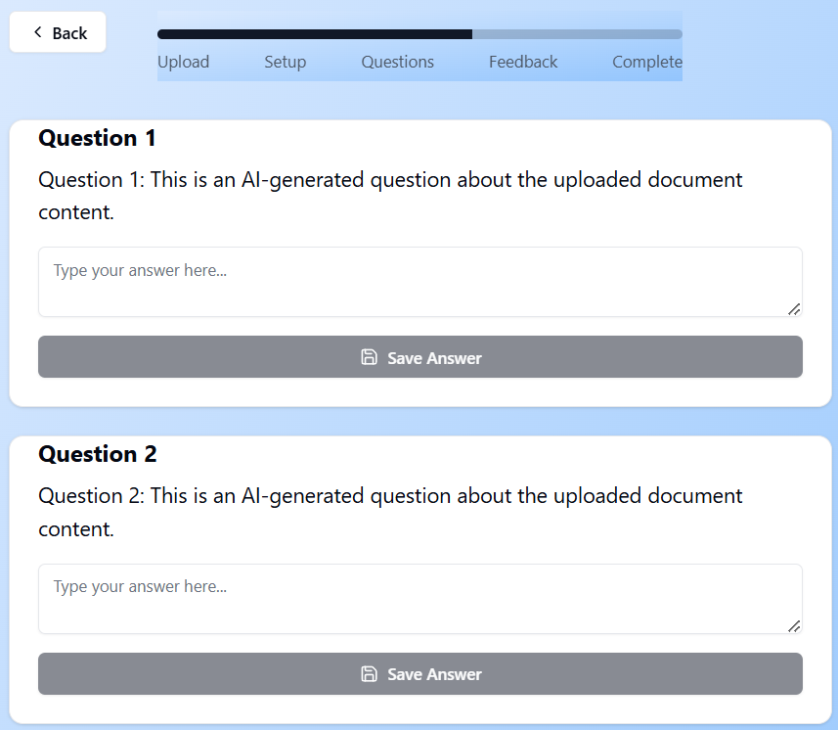
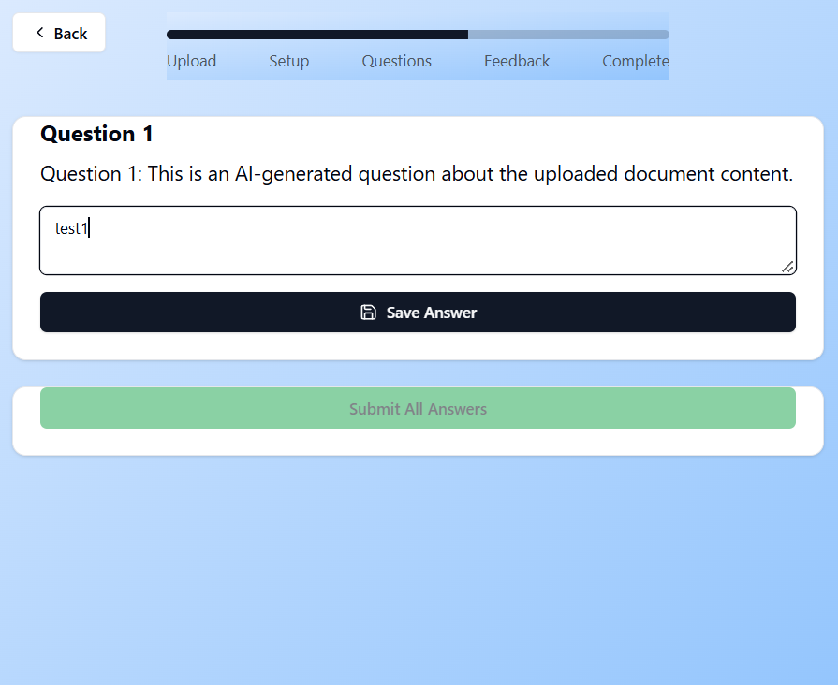
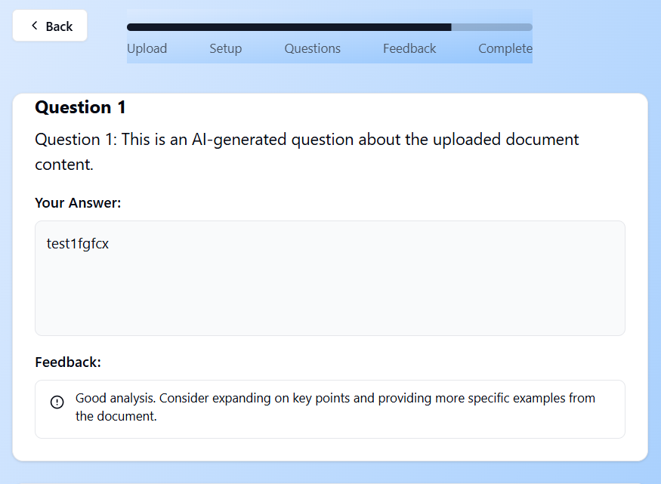
SCREENSHOTS
15

Slide 17
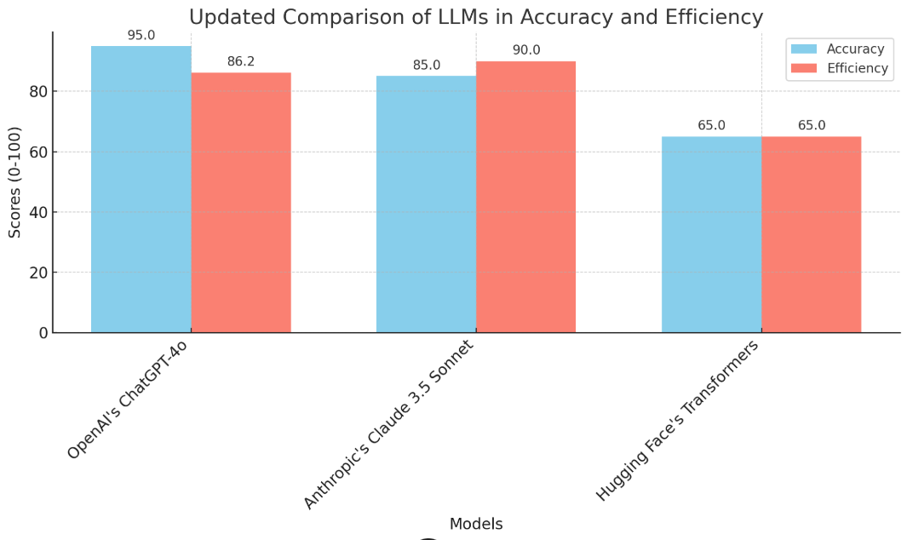
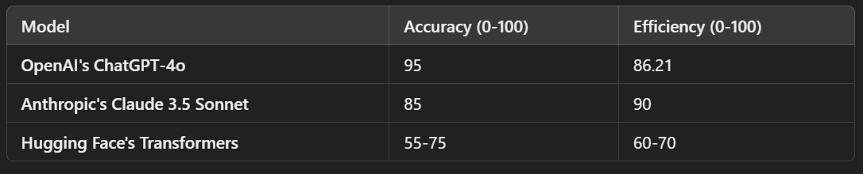
RESULT ANALYSIS
16
The result analysis evaluates the performance and effectiveness of the application in various aspects, ensuring it meets user expectations and fulfills its objectives.
Answer Evaluation
User Performance Metrics
Topic-Wise Analysis
Question Quality
Feedback Effectiveness
System Efficiency
User Engagement
Error Rate and Robustness
Comparative Analysis

Slide 18
17
CONCLUSION
In conclusion, this web application harnesses the power of large language models (LLMs) to provide a streamlined, automated solution for document analysis, question generation, and answer evaluation.
By supporting multiple document formats and leveraging NLP to extract key topics, it provides a valuable tool for both educators and students, facilitating a streamlined and personalized assessment process.
The integration of LLMs such as GPT, Claude, and LLaMA ensures that the generated questions are contextually relevant and accurate, making it a robust educational aid.
The integration of natural language processing techniques within the LLM framework allows for nuanced understanding and analysis, facilitating effective, context-aware question generation and precise answer assessment.
Ultimately, this application represents a valuable tool for enhancing engagement with digital content, promoting deeper comprehension, and supporting data-driven decision-making across diverse use cases.

Slide 19
18
ANY QUERIES?

